Slide 1
Work-case 8
Performed by student
group RPZ-13a
Kateryna Hranat

Slide 2
Common Tasks in Terminal

Slide 3

Viewing Files and Folders through a Terminal-based midnight commander
‘ncdu’: This is a disk usage analyzer that helps you browse through directories and files.
‘ranger’: A terminal-based file manager that uses a vi-style keybinding for easy navigation.
‘midnight commander (mc)’: A powerful file manager with a classic dual-pane layout.

Slide 4
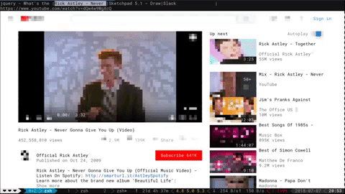
Browsing Web Pages through a Terminal-based Browser
‘lynx’: A text-based web browser.
‘w3m’: Another text-based browser with additional features like displaying images in the terminal.

Slide 5

Viewing Email in the Terminal
‘mutt’: A text-based email client that supports various email protocols like IMAP and POP3.
‘alpine’: Another terminal-based email client, designed with a simpler interface.

Slide 6

Listening to Music through the Terminal
`cmus`: A lightweight terminal-based music player with support for various audio formats.
`mpg123`: A command-line MP3 player.

Slide 7

Downloading Torrents through the Terminal
`transmission-cli`: A command-line interface for the Transmission BitTorrent client.
`rtorrent`: A command-line BitTorrent client with scriptable features.

Slide 8

Scheduling Actions in a Calendar and Setting Reminders through the Terminal
`calcurse`: A text-based calendar and scheduling application.
`remind`: A flexible reminder application with a variety of features.

Slide 9

Viewing Images in the Terminal
`timg`: A terminal image viewer that supports various image formats.
`chafa`: Converts images to ASCII for terminal display.

Slide 10
Common Tools for System Administrators

Slide 11

Editing Text Files (Text Editors)
`vim`: A highly customizable text editor with advanced features and plugins.
`nano`: A simpler text editor with a user-friendly interface.
`emacs`: Another powerful text editor with extensive customization capabilities.

Slide 12

Monitoring System Processes and Resources
`htop`: An interactive process viewer and system monitor.
`glances`: A cross-platform monitoring tool that shows various system metrics.
`atop`: A system and process monitor with historical data storage.

Slide 13
Fun Easter Eggs in the Terminal

Slide 14

Terminal-based Locomotive (Hint for Travel)
sl: A fun command that shows a steam locomotive animation.
Star Wars in the Terminal
telnet towel.blinkenlights.nl: Streams an ASCII version of Star Wars Episode IV: A New Hope.
Dialog with a Cow
cowsay: Displays a message with a cow's speech bubble.
cowthink: Similar to cowsay, but the cow is thinking instead of speaking.

Slide 15

Additional Fun Interactions
`figlet`: Converts text into large ASCII art.
`fortune`: Displays random fortunes, quotes, or jokes.

Slide 16

Conclusions:
During the execution of the tasks outlined in the Work Case, I discovered that a wide range of operations typically associated with graphical interfaces can be effectively handled in a terminal-only environment. Tools like `ranger` and `mc` enabled efficient file management, while text-based browsers like `lynx` and `w3m` allowed for basic web browsing. For email, `mutt` and `alpine` proved to be reliable clients that work entirely within the terminal. Playing music was straightforward with `cmus` and `mpg123`, while `transmission-cli` and `rtorrent` made torrent downloads possible without a graphical interface. Tools like `calcurse` provided calendar and scheduling functionalities. Monitoring system resources and processes was manageable with `htop` and `glances`. Additionally, I explored some fun aspects of the terminal, like watching an ASCII version of Star Wars or interacting with a talking cow using `cowsay`.
Author – Kateryna Hranat

Slide 17
Thank you for attention!

